Slide 1






ACCENTURE - 1
Sustainable Energy Transition:
Business Decision Support System (BDSS) for Analyzing Hydrogen Consumption, Subsidies, and Gas Trade
Mentors: Dr. Mel Devine (UCD), Alton Marx (Accenture), Alexandra Bolster (Accenture)
Teammates: Akhilesh Kapoor, Anushka Jain, and Disha Shetty

Slide 2


BACKGROUND
ACTION
EU aims for climate neutrality by 2050, Ireland targets 51% emission reduction by 2030.
Ireland aims to achieve 80% renewable electricity by 2030.
“Hydrogen is a clean energy carrier that produces only water vapour when used as fuel.“
EU's hydrogen strategy aims for 10 million tonnes of renewable hydrogen by 2030.
Current situation
The world will exceed 1.5℃ by 2035 and faces a 2.5℃ warming by 2100.

Slide 3






PREVIOUS LITERATURE:
Research papers* have employed models to optimize hydrogen infrastructure and supply chains.
BUSINESS VALUE FOR A PARTICULAR COUNTRY
OBJECTIVE:
Our novelty was to create a BDSS, delving into three critical aspects of the energy landscape:
Reduce dependence on traditional fossil fuels
Hydrogen Consumption Estimation
Revenue generation through hydrogen exports
Subsidies on Energy Products
How to create a shift towards green hydrogen
European National Gas Pipeline Network
* Razmi, J., Babazadeh, R. and Kaviani, M.A. (2018). Optimisation of dynamic hydrogen supply chain network: a mathematical programming approach. International Journal of Applied Management Science, 10(3), p.192. doi:https://doi.org/10.1504/ijams.2018.093801.
* De-León Almaraz, S., Rácz, V., Azzaro-Pantel, C. and Szántó, Z.O. (2022). Multiobjective and social cost-benefit optimisation for a sustainable hydrogen supply chain: Application to Hungary. Applied Energy, 325, p.119882. doi:https://doi.org/10.1016/j.apenergy.2022.119882

Slide 4







METHOD & APPROACH
Modelling
ALGORITHMS
Ordinary Least Square
Multiple Layer Perceptron
FBProphet
Data Preparation
Source
(International Energy Agency, World Bank)
Load & Transform
Visualisation
Business Insights
(Descriptive and Predictive Analysis)

Slide 5
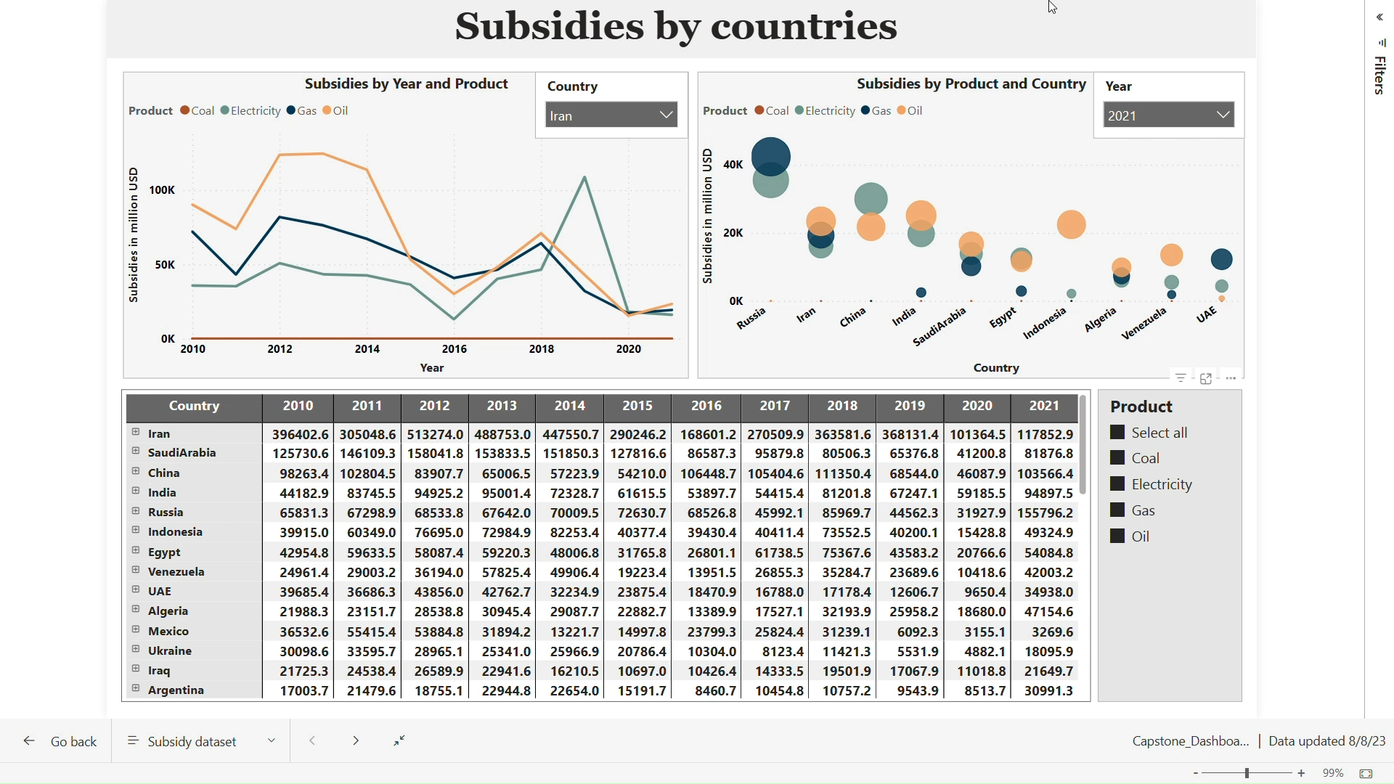
RESULT
Note: All values in million USD

Slide 6
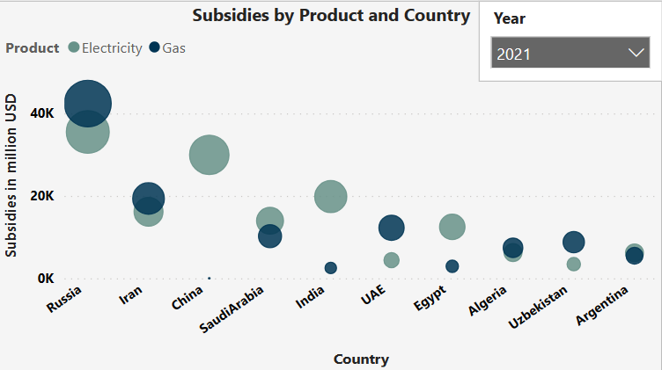
INFERENCE – Subsidies for Energy Products
Country​ | Electricity (Million USD)​ | Gas (Million USD)​
Iran​ | 16148.9​ | 193554​
Russia​ | 35509.2​ | 42388.9​
Top 10 countries of 2021 investing strategically in electricity to reduce hydrogen production costs.
Fossil fuel subsidies could be transferred and replicated for future hydrogen energy subsidies.

Slide 7
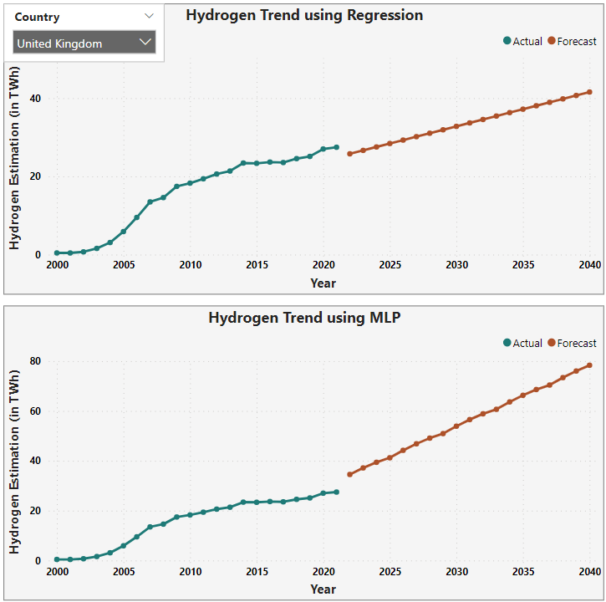
Hydrogen Consumption Estimation
RESULT
INFERENCE
Country​ | OLS R-Squared​ | OLS RMSE​ | MLP R-Squared​ | MLP RMSE​
Germany​ | 0.8964 | 5.3161​ | -14.1927​ | 3.3709​
UK​ | 0.9924​ | 0.7721​ | -0.4778​ | 1.4935​
India​ | 0.9168​ | 39.3398​ | 0.6721​ | 34.4978​
* Predicted for 7 other countries
Ordinary Least Square (OLS) performs better than Multiple Layer Perceptron (MLP) in predicting Hydrogen Estimation for most countries, with higher R-Squared and lower RMSE.
UK excels in prediction using OLS and MLP.
NOTE: OLS - Linear Regression Model, MLP - Neural Network Model

Slide 8
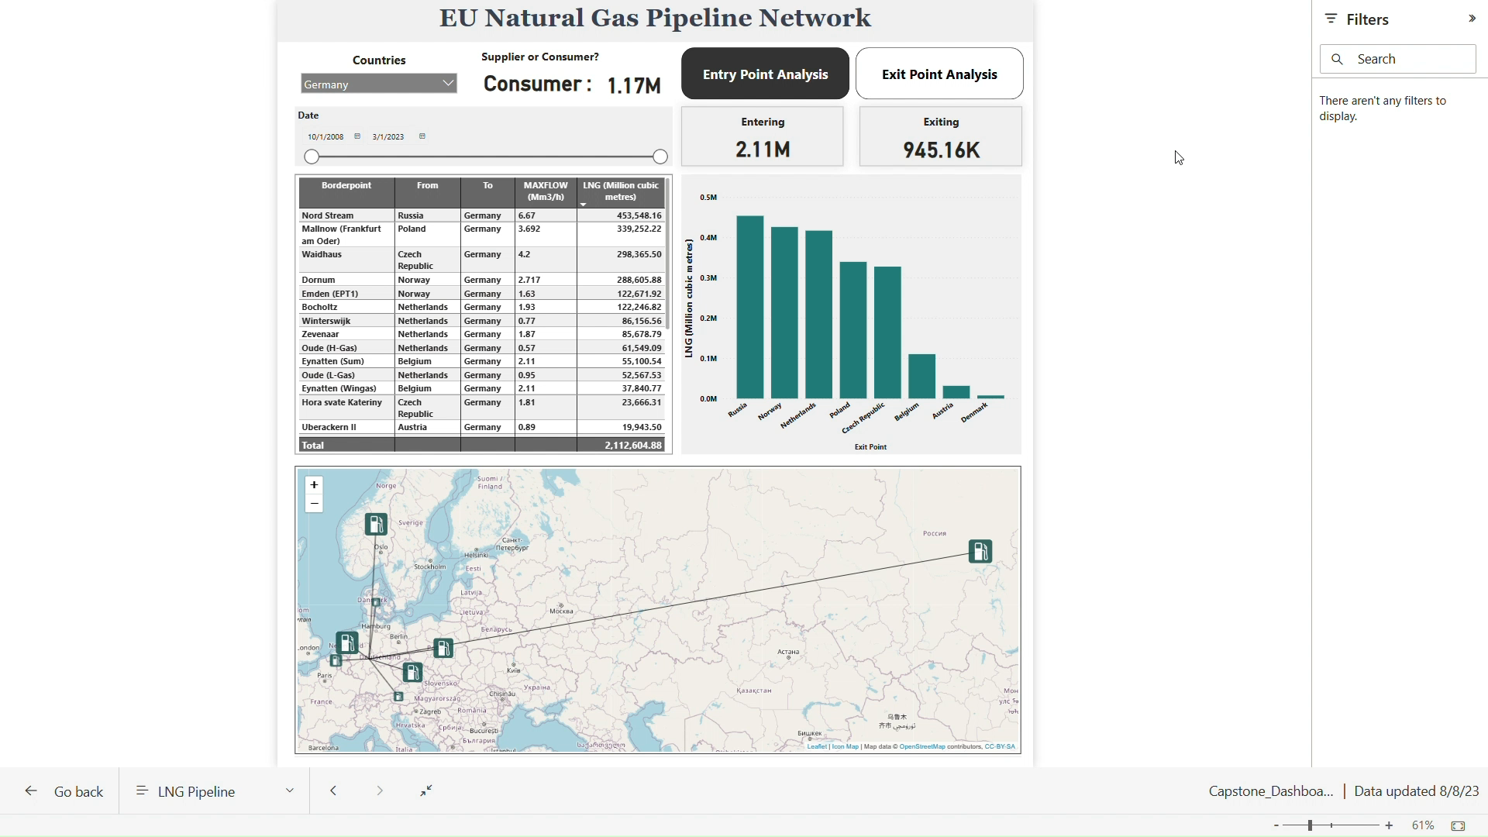

EU Natural Gas Pipeline Network
INFERENCE
By visualising the volumes through each entry point, we can identify the significance of both pipelines and LNG terminals in facilitating hydrogen imports.​
Utilising EU Gas Pipeline Analysis to drive informed surplus Hydrogen Export Strategies.

Slide 9




CONCLUSION
The BDSS can be used as a critical initial step for exploring the dynamics of the hydrogen market.​
By predicting hydrogen consumption, subsidies can be strategized to reduce production costs.​
Potential export avenues for Ireland's surplus hydrogen, such as Germany, can be discovered through the utilization of BDSS.​
BDSS can assist governments and groups in the design of efficient policies for transitioning to clean energy.

Slide 10
FUTURE SCOPE
01
03
Enhanced Hydrogen Seasonal Analysis using robust date hierarchy. ​
02
Add more predictors and countries’ data to enrich hydrogen consumption estimations. ​
EU Subsidy Data Analysis: Guiding Policymakers in lowering Hydrogen Production Costs​
04
Acquire critical mineral prices (Ni, Zr, Pt) for insightful cost analysis of hydrogen production, facilitating better investment decisions and strategic planning.​

Slide 11
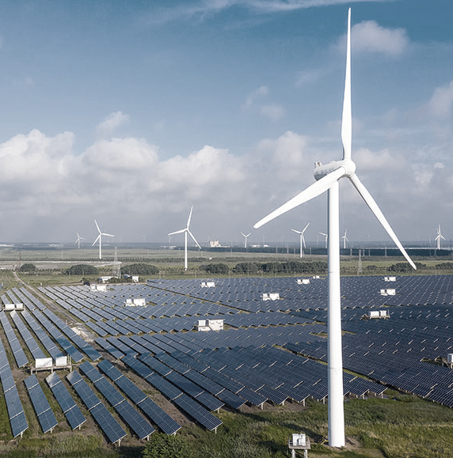
THANK YOU
Special Thanks to Our Mentors:
Dr. Mel Devine (UCD)
Alton Marx (Accenture)
Alexandra Bolster (Accenture)

Slide 12
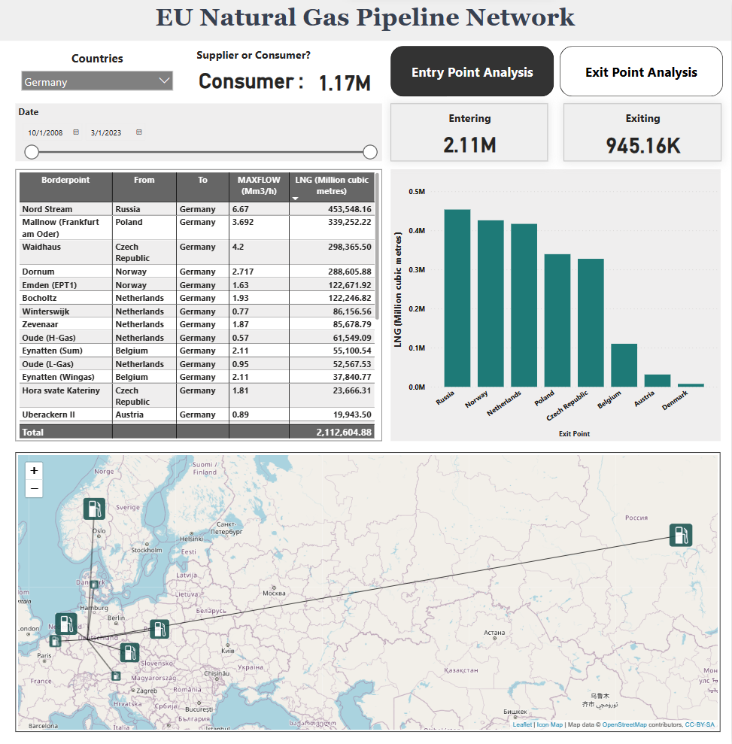
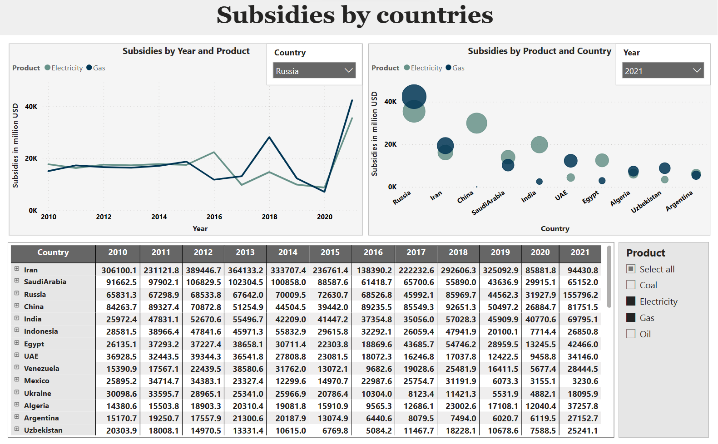
Process Flow
MSc Business Analytics Capstone – Accenture 1
Sustainable Energy Transition:
Business Decision Support System (BDSS) for Analyzing Hydrogen Consumption, Subsidies, and Gas Trade
Data Preparation
OBJECTIVE:
To conduct a comprehensive analysis and create a BDSS, delving into:
Hydrogen Consumption Estimation
Subsidies on Energy Products
European National Gas Pipeline Network
BDSS UTILISATION:
Critical initial step for exploring the dynamics of the hydrogen market.​
By predicting hydrogen consumption, subsidies can be strategized to reduce production costs.​
Potential export avenues for Ireland's surplus hydrogen, such as Germany.​
Can assist governments and groups in the design of efficient policies for transitioning to clean energy.
Mentors:
Dr. Mel Devin (UCD),
Alton Marx (Accenture),
Alexandra Bolster (Accenture)
Modelling
Teammates:
Akhilesh Kapoor
Anushka Jain
Disha Raviraj Shetty
BUSINESS VALUE:
Reduce dependence on fossil fuels
Revenue generation through hydrogen exports
How to create a shift towards green hydrogen
Load & Transform
Visualisation
Business Insights

